Slide 1

UNIT 7A
WHAT? THE SHOP

Slide 2
PRONUNCIATION – CONFUSING VOWEL SOUNDS
ɪ iː
slip sleep
ship sheep
fit feet
gin jean
Rick sits in his seat and speaks to the teacher.

Slide 3








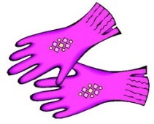




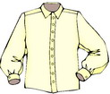


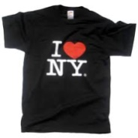


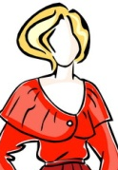



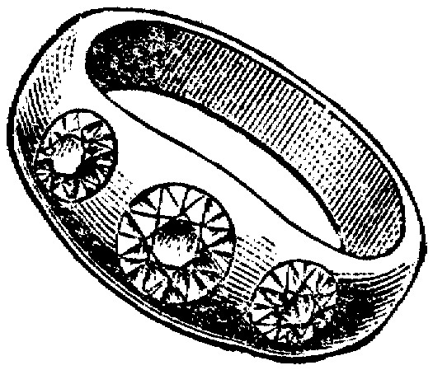
VOCABULARY – NOUNS
A TOY | A DRUM | A DRESS | SHOES
A DOLL | A GUITAR | A COAT | GLOVES
A BELL | A PIANO | A TIE | GLASSES
A SOFA | A SHIRT | A SCARF | CLOTHES
A FLOWER | A T-SHIRT | TROUSERS | A BRACELET
A FLOWER VASE | A BLOUSE | JEANS | A NECKLACE
MONEY | A SKIRT | SLIPPERS | A RING

Slide 4

VOCABULARY - PICTURES
1 | 8 | 15 | 22
2 | 9 | 16 | 23
3 | 10 | 17 | 24
4 | 11 | 18 | 25
5 | 12 | 19 | 26
6 | 13 | 20 | 27
7 | 14 | 21 | 28

Slide 5
VOCABULARY - LISTENING
1 | 8 | 15 | 22
2 | 9 | 16 | 23
3 | 10 | 17 | 24
4 | 11 | 18 | 25
5 | 12 | 19 | 26
6 | 13 | 20 | 27
7 | 14 | 21 | 28

Slide 6
GRAMMAR
PRONOUNS
 | SUBJECT | OBJECT | POSSESSIVE ADJECTIVE
TÔI BẠN ANH ẤY CÔ ẤY NÓ | I YOU HE SHE IT | ME YOU HIM HER IT | MY HOUSE YOUR HOUSE HIS HOUSE HER HOUSE ITS HOUSE
CHÚNG TÔI CÁC BẠN CHÚNG, HỌ | WE YOU THEY | US YOU THEM | OUR HOUSE YOUR HOUSE THEIR HOUSE

Slide 7

CONVERSATION – WHERE ARE YOU FROM?
JOHN: Hi! My name is John. What’s your name?
MAI: I’m MAI.
JOHN: My? How do you spell that?
MAI: M.A.I.
JOHN: Oh. Nice to meet you, Mai.
MAI : Glad to see you, John.
JOHN: So, where are you from, Mai?
MAI : I’m from Dalat, Vietnam. How about you, John?
JOHN: Oh. I’m from Texas, U.S.A.
HOMEWORK
Chép tất cả các danh từ trong phần vocabulary, mỗi chữ 2 dòng vào vở bài tập B.
Viết 1 dòng số ít, 1 dòng số nhiều.

